Slide 1
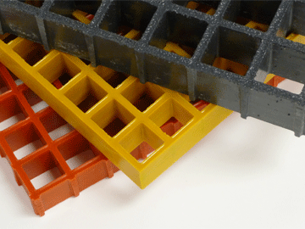
MOULDED GRATING
Product Brochure

Slide 2
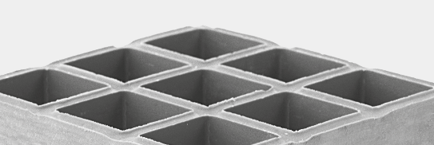
STANDARDS | Dudhani Poly – Extrusions Pvt Ltd
Our products comply with the following standards:
Product | American Standards (ASTM)
ASTM E84 - Tunnel Test | This test measures the behaviour of laminates, which form the roof of a tunnel 7.62m long and 0.51m wide. Flame spread results are compared with a scale reading from 0 (asbestos cement board) to 100 (red oak flooring). Fuel contribution and smoke emission properties can also be measured during the test. UL 94: The Underwriters Laboratory of America carries out this test, which is based on the burning behaviour of small laminate samples (127mm x 12.7mm). The specimens, which can be tested horizontally or vertically, are ignited using a small laboratory burner, and classified according to flame spread and their self extinguishing properties. The first letter of the classification denotes the plane of testing (H- horizontal and V - vertical), with HB being the lowest classification. Vertical classes are V-0, V-1, V-2and 5V, with 5V being the highest rating. This test is recognised throughout the composites industry.
FRP Flooring & Grating FRP Handrails | BS4592:0 2006+A1 2012 Industrial Flooring, Stairs and Handrails for General Duty (0.36kN/m) and Heavy Duty (0.74kN/M) BS ENISO 141 22 Safety Of Machinery: Permanent Means of Access to Machinery
Pultruded Profiles | ASTM Reinforced Plastic Composites, specifications for pultruded profiles.

Slide 3
PRODUCTS | Types of Dudhani GRATINGS
Meniscus Top:
The top surface grating provides superior slip resistant footing in most environments including wet or oily conditions and is the standard surface for most molded gratings
Integrally Grit Top:
The optional grip top of grating has a quartz grit which is integrally applied, cured and sealed onto the surface providing excellent slip resistant footing.

Slide 4
SPECFICATIONS | Dudhani Poly – Extrusions Pvt Ltd
We stock a range of high performance glass fibre reinforced flooring, grating and anti-slip surfaces suitable for the most aggressive industrial environments.
The advanced properties of FRP include corrosion resistance, incredible strength and durability, ease of installation and zero maintenance. Our anti-slip product range mitigates the risk of slips and falls, and meets relevant Health & Safety standards. Lightweight and impact resistant, our grating and flooring systems can be easily installed onsite. Our competitive pricing enables us to offer a direct alternative to galvanized steel and aluminum.
FRP Open-Mesh Molded Grating
Available in a number of different panel sizes, thickness, color and surface finish. All gratings are fire retardant to ASTM E 84. The grating is easy to cut to shape making for fast installation even in complex layouts.
The following grating panels are available within 5 - 7 days
Thickness (mm) | Mesh Size | Panel Size (mm) | Colour (m) | Weight (kg per panel) | Surface Type
25 | 38 x 38 | 1.22 x 3.66 | ANY | 55 | gritted anti-slip / meniscus
38 | 38 x 38 | 1.22 x 3.66 | ANY | 76 | gritted anti-slip / meniscus
Thickness (mm) | Mesh Size | Panel Size (mm) | Colour (m) | Weight (kg per panel) | Surface Type
28 | 38 x 38 | 1.22 x 3.66 | ANY | 62 | plain / chequered
41 | 38 x 38 | 1.22 x 3.66 | ANY | 84 | plain / chequered

Slide 5
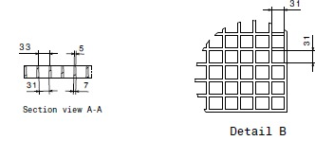
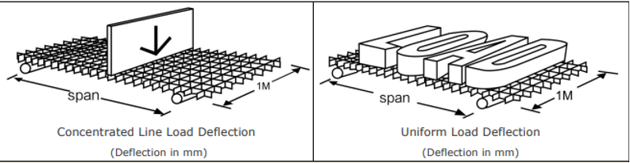
GRATING DETAILS | Dudhani Poly – Extrusions Pvt Ltd
38 mm Deep x 38 mm Square Mesh
# of Bars / Ft of Width | Load Bar Width | Open Area | Load Bar Centers | Approximate Weight
7 / 5 Thick | 38 mm | 70 % | 38 mm | 17 psm
Molded Grating Properties: W = 1.220 x L = 3.660 x H = 38 x T = 7/5
Load Bearing Strength: 375 kgs Per Sq Mtr

Slide 6
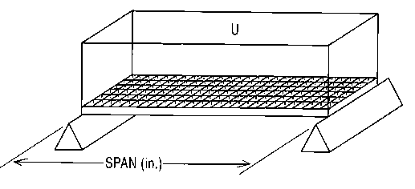
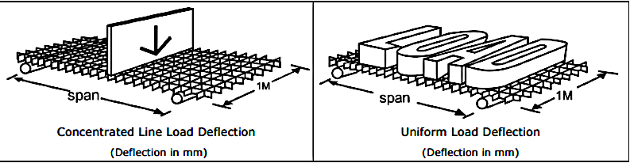
LOAD TABLE | Dudhani Poly – Extrusions Pvt Ltd
Moulded Grating Load Table
Clear Span (L) mm | Height of grating in mm | Mesh Size in mm | Deflection as per L/200 in mm | Uniform distribution load (Kg / m2) | Maximum recommended load (Kg / M2)
300 | 30 | 38.1 X 38.1 | 1.5 | 7066 | 16959
400 | 30 | 38.1 X 38.1 | 2.0 | 2650 | 7955
500 | 30 | 38.1 X 38.1 | 2.5 | 1110 | 3332
600 | 30 | 38.1 X 38.1 | 3.0 | 550 | 1651
700 | 30 | 38.1 X 38.1 | 3.5 | 425 | 1277
800 | 30 | 38.1 X 38.1 | 4.0 | 331 | 994
900 | 30 | 38.1 X 38.1 | 4.5 | 289 | 866

Slide 7
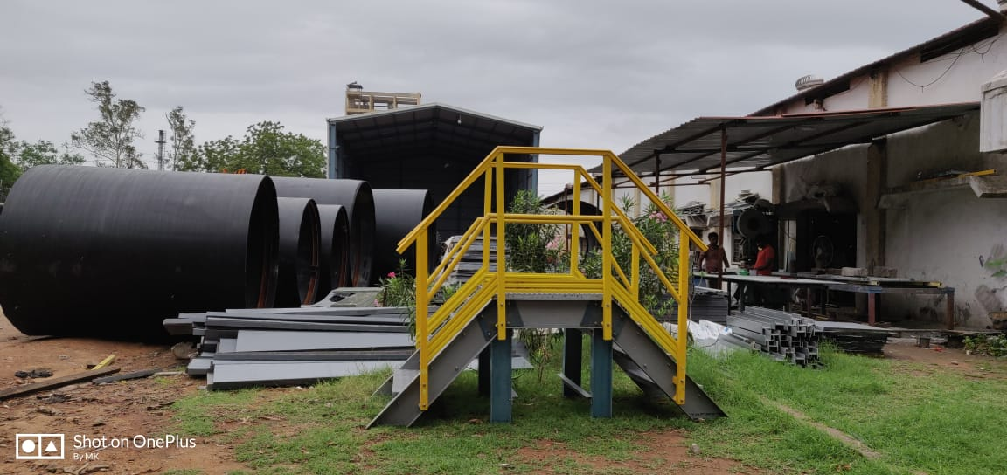
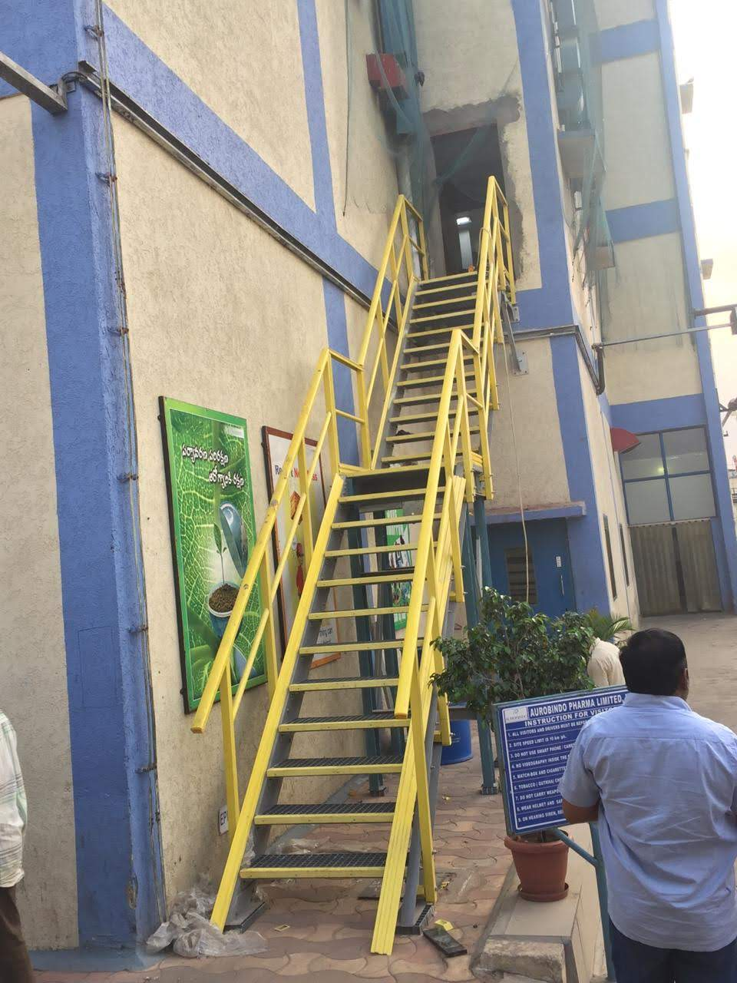
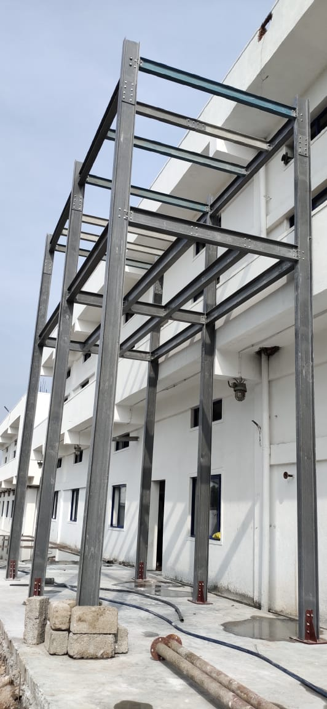
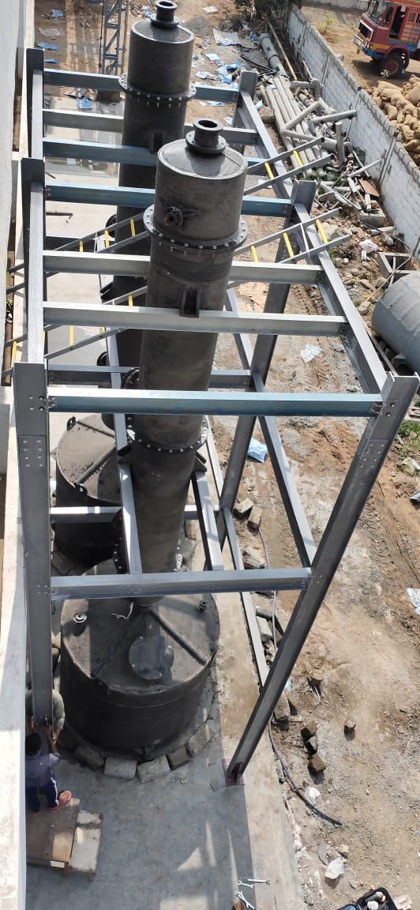
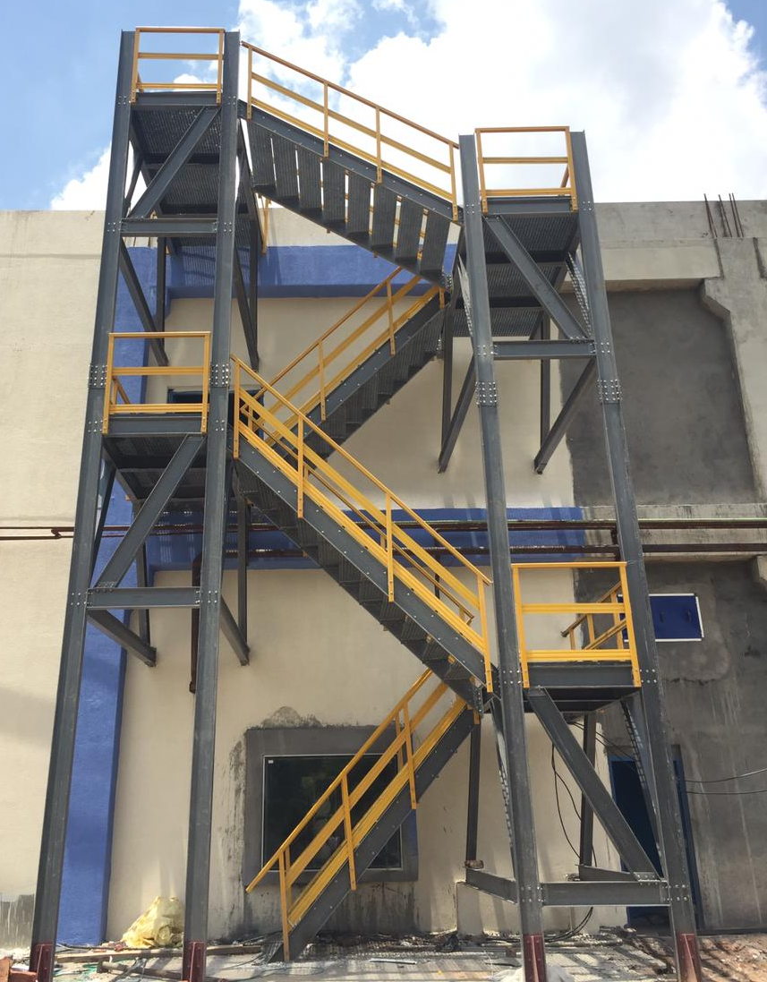
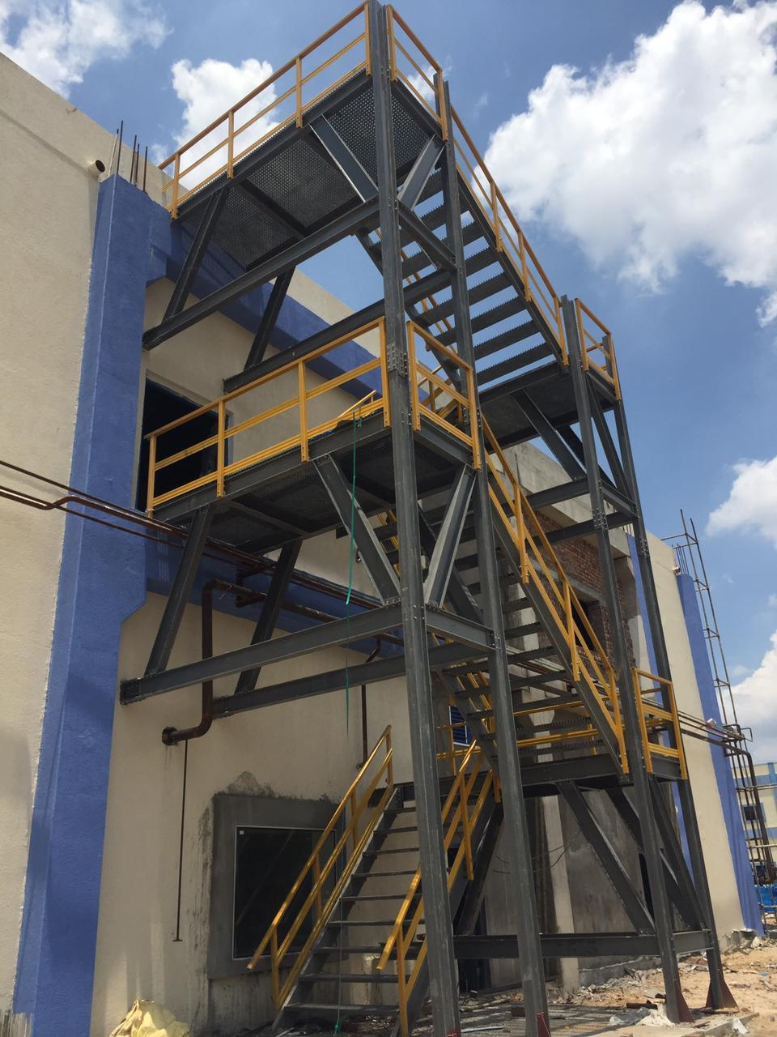
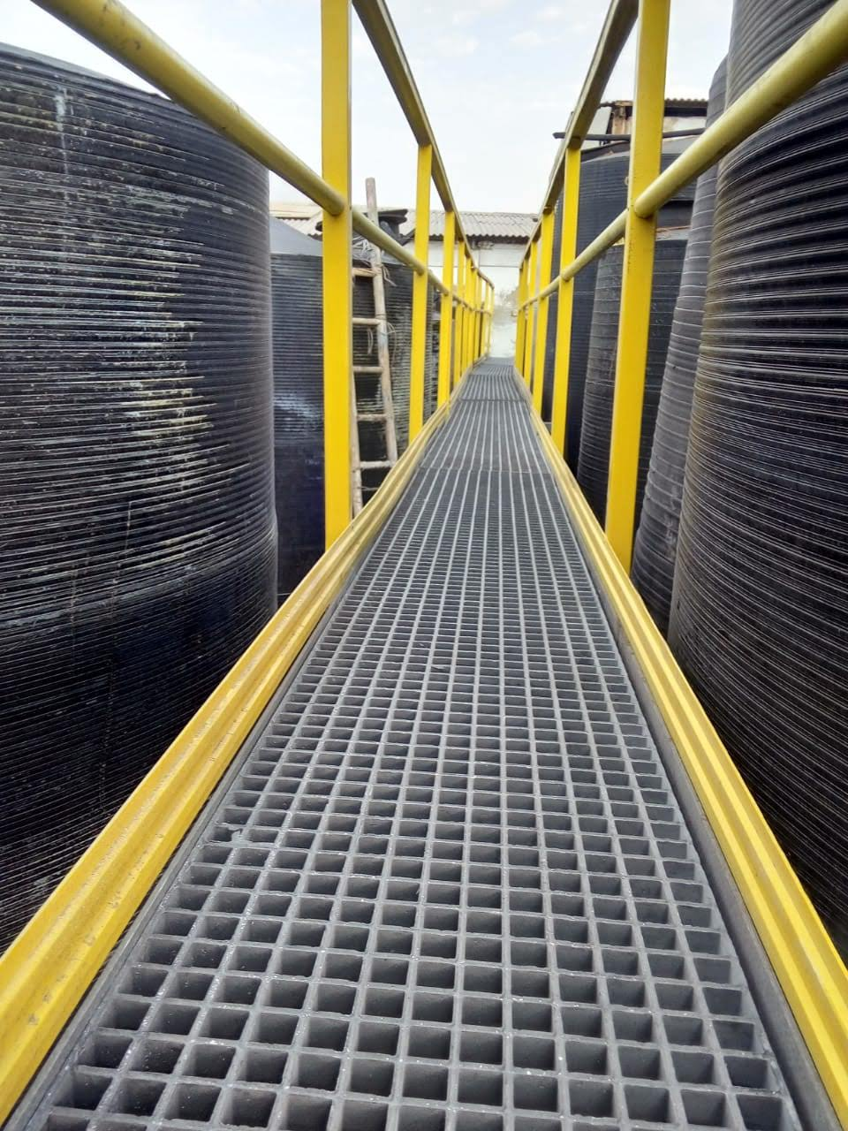
CASE STUDY | Dudhani Poly – Extrusions Pvt Ltd

Slide 8
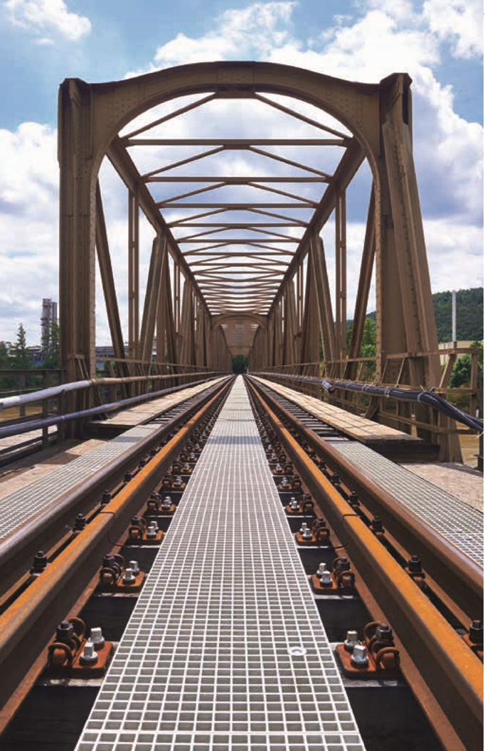
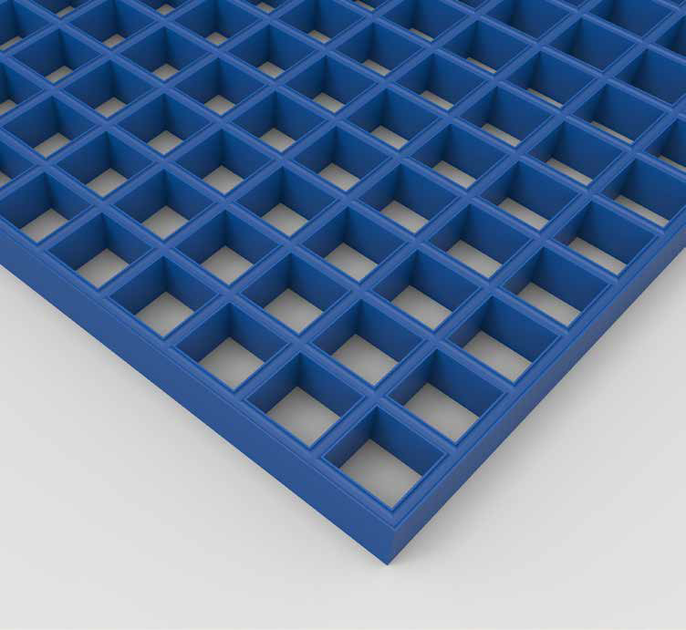
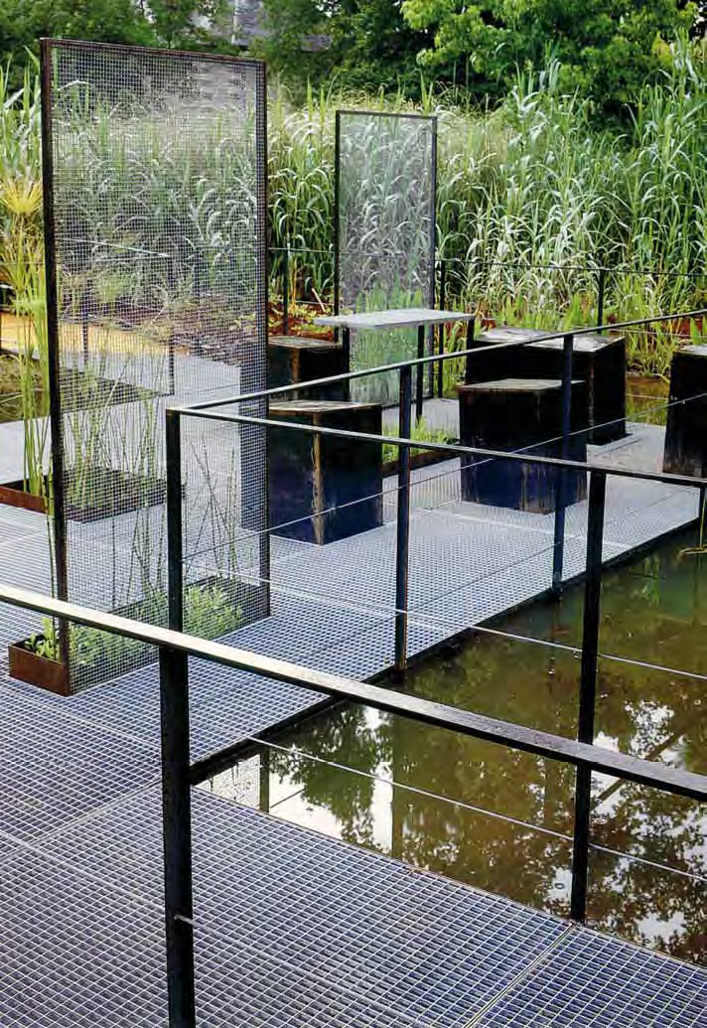
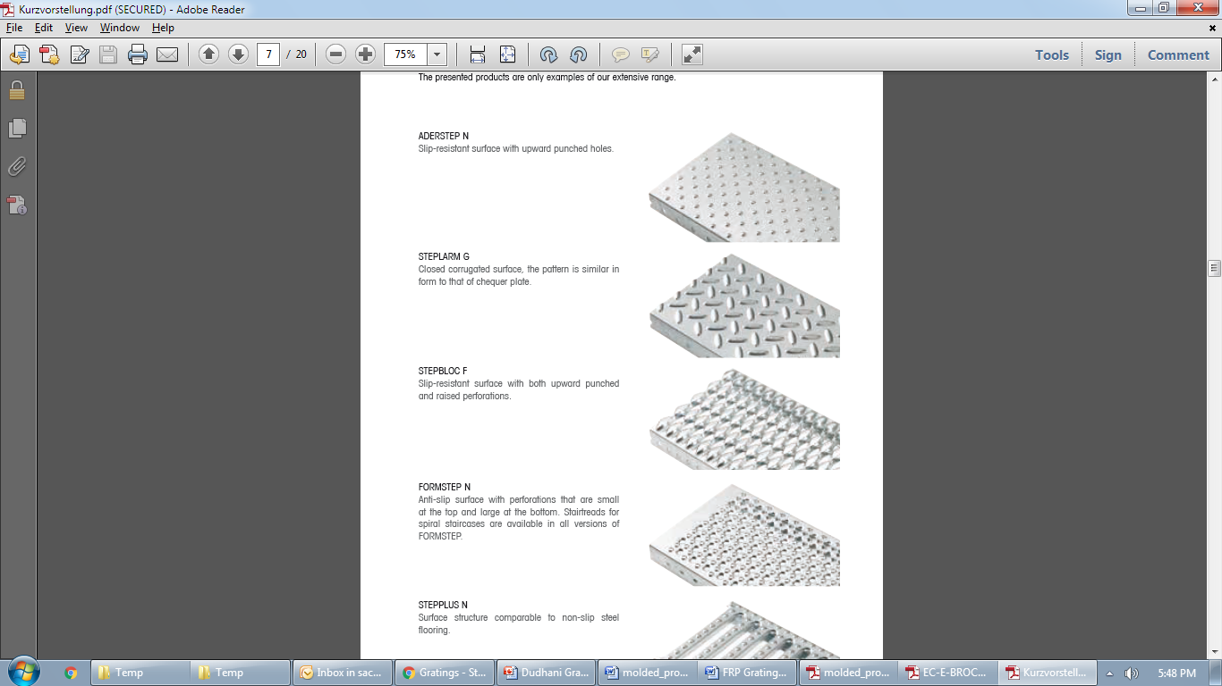
Oil & Gas
Pharmaceutical
Power
Pulp & Paper
Architectural
Bridge & Highway
Chemical
Commercial
MARKET SECTORS
Recreation
Telecommunications
Transportation
Water & Wastewater
Food & Beverage
Manufacturing
Metals & Mining
Microelectronics

Slide 9
FRP VS TRADITIONAL MATERIAL | Dudhani Poly – Extrusions Pvt Ltd
COMPAIR | FRP | STEEL | ALUMINIUM | TIMBER
Corrosion Resistance | Excellent Corrosion Resistance. Can be designed to suit most chemical environments | Low Corrosion Resistance. Subject to oxidation and corrosion. Requires painting or galvanizing | Low Corrosion Resistance. Subject to galvanic corrosion. Requires anodizing or other coatings | Low Corrosion Resistance. Can warp, rot and decay from exposure to moisture, water and chemicals. Requires coating or preservatives.
Weight | Lightweight. (up to 80% lighter than steel & approx. 30% the weight of aluminum) | Extremely Heavy. Requires heavy lifting gear to maneuver | Lightweight. (about 1/3 that of copper or steel) | Dependent on size.
Slip Resistance | Extremely High Slip Resistance. Engineered Composites integral grit finish offers slip resistance for a walking surface even in wet or oily conditions | Little or No Slip Resistance. A major health & safety risk for companies | Little or No Slip Resistance. A major health & safety risk for companies | Little or No Slip Resistance. A major health & Safety risk for companies
Conductivity | Non-Conductive. No earthing required | Conducts Electricity. Earthing required | Conducts Electricity. Earthing required | Non-Conductive. No earthing required
Strength | High Strength-to-Weight Ratio. Stronger than steel on a kg-for-kg basis | High Strength. Heavy in weight to achieve its high strength properties | Low Strength. | Dependant on Size. To achieve reasonable strength properties product sizes have to be extremely large
Impact Resistance | High Impact Resistance. Will not permanently deform under impact | Medium to Low Impact Resistance. Can permanently deform under impact | Low Impact Resistance. Easily deforms under impact | Medium to Low Impact Resistance. Can permanently deform under impact
Fabrication | Easily Field Fabricated. Can be easily field fabricated using simple carpenter tools with carbon or diamond tip blades. Lightweight for easier erection and installation | Fabrication more Complex. Often requires welding and cutting torches. Heavier material requires special handling equipment to erect and install. | Fabrication more Complex. Welding, brazing, soldering or mechanical joining required. | Easily Fabricated. Fabricated using tools such as jigsaws and circular saws.

Slide 10
FRP VS TRADITIONAL MATERIAL | Dudhani Poly – Extrusions Pvt Ltd
COMPAIR | FRP | STEEL | ALUMINIUM | TIMBER
Maintenance | Maintenance Free. FRP has a design life of 50 years | Constant Maintenance Required. Due to rust, damage, or re-painting. High cost implications. | Constant Maintenance Required. Due to rust, damage, or re-painting. High costs implications. | Constant Maintenance. Due to rot, decay, re-painting, or insect attacks. High cost implications.
Cost | Long Term Cost Savings. Lower installation and maintenance costs in industrial Application = very low lifecycle costs | Low Cost, High Maintenance. Lower initial material cost, however costly to maintain. High lifecycle costs. | Low Cost, High Maintenance. Lower initial material cost, however costly to maintain. High lifecycle costs. | Low Cost, High Maintenance. Lower initial material cost, however costly to maintain. High lifecycle costs.
Ergonomic | Good Ergonomic Properties. The innate elasticity of FRP provides comfort to workers as it has a slight 'give' underfoot | No Ergonomic Properties. Steel does not provide comfort underfoot. Can lead to back ache for workers who are on-foot for long periods of time. | No Ergonomic Properties. N/A | Good Ergonomic Properties. Provides comfort underfoot
EMI/RFI Transparency | Transparent to EMI/RFI transmissions | Can interfere with EMI/RFI transmissions. | Can interfere with EMI/RFI transmissions. | Transparent to EMI/RFI transmissions.
Aesthetics | Pigments added to Resin. The pigments provide colour throughout the part. No maintenance required. Bespoke colours available | Painted or Dyed for Colour. To maintain colour and corrosion resistance, repainting may be required | Painted or Dyed for Colour. To maintain colour and corrosion resistance, repainting may be required. | Primed and Painted for Colour. To maintain colour and corrosion resistance, repainting may be required

Slide 11
ABOUT US
DUDHANI POLY-EXTRUSIONS PVT. LTD, a diverse manufacturing organization has carved a niche for itself in the market by delivering high-quality products with its core strength in a comprehensive range of corrosion-free products. As an organisation, our focus is geared towards using the highest quality raw material. Dudhani also manufactures other customized plastic items depending on the client’s requirement and caters to a wide range of industries. With a goal to make sure customers are contented, our technical experts are constantly creating new and better products. Dudhani operates on a collaborative culture that is built on reliability, quality, and occupational safety. We also have a direct business policy and profound industry knowledge, thus allowing us to meet all the requirements of our client. its our core strength in manufacturing a comprehensive range of corrosion free products

Slide 12
DISCLAIMER
DISCLAIMER
Information posted is merely for educational and informational purposes. It is not intended as a substitute for professional advice. Should you decide to act upon any information on this information, you do so at your own risk. While the information on this has not been verified to the best of our abilities, we cannot guarantee that there are no mistakes or errors.
We reserve the right to change this policy at any given time, of which you will be promptly updated. If you want to make sure that you are up to date with the latest changes, we advise you to frequently visit this page.

Slide 13
